Slide 1
Structural Machine Learning Models and Their Applications Paper Presentation II
Self-training with Noisy Student improves ImageNet classification
Qizhe Xie, Minh-Thang Luong, Eduard Hovy, Quoc V. Le
Google Research, Brain Team, Carnegie Mellon University
Billion-scale semi-supervised learning for image classification
Zeki Yalniz, Hervé Jégou, Kan Chen, Manohar Paluri, Dhruv Mahajan
2020 IEEE/CVF Conference on Computer Vision and Pattern Recognition (CVPR)
8108050001 陳奕傑
2021/06/21

Slide 2
Content
Introduction
Based model-EfficientNet
Loss function
Dataset
Training Detail
Result and Performance
實作
Reference
Notes:
PSEUDO LABEL
https://zhuanlan.zhihu.com/p/35753177

Slide 3



1-1.Introduction- Self-training with Noisy Student improves ImageNet classification
1) train a teacher model on labeled images,
2) use the teacher to generate pseudo labels on unlabeled images
3) train a student model on the combination
of labeled images and pseudo labeled images.
training
Label data
teacher
testing
Add label
UnLabel data
teacher
Pseudo label data
?Pseudo label
Label data
+ Noise
student
teacher
Pseudo label data

Slide 4

1-2.Introduction-
Billion-scale semi-supervised learning for image classification
1) train a teacher model on labeled images.
2) use the teacher to generate pseudo labels on unlabeled images.
3) train a student model on the pseudo labeled images.(Select Top K for each classification)
4)Finetunig student model on the labeled images.
training
Label data
teacher
testing
Add label
UnLabel data
teacher
Pseudo label data
training
Finetuning
+
Pseudo
label data
student
Label data
student
Final Model

Slide 5
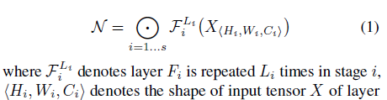
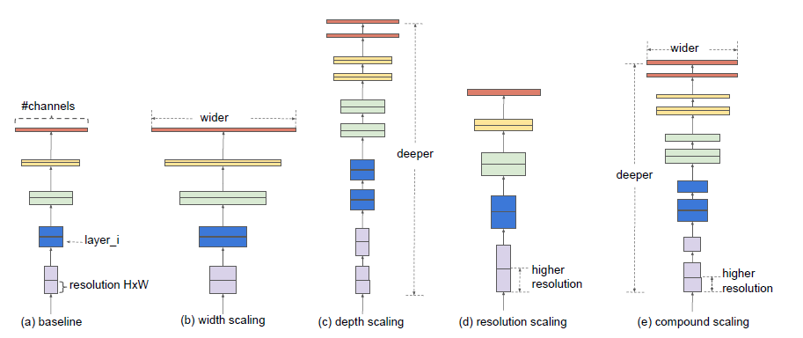
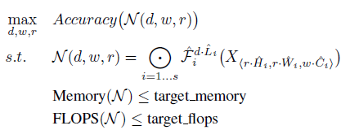
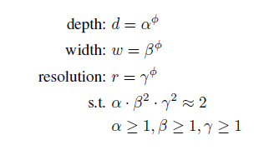
2.Based model – Efficient Net
ICML2019
combounding scale
depth scaling擴增如右圖(c)增加layer數
width scaling (b)增加的channel數(like rgb)
image size 其實就是增加其resolution的部分!
Notes:
https://blog.csdn.net/u014380165/article/details/90812249

Slide 6
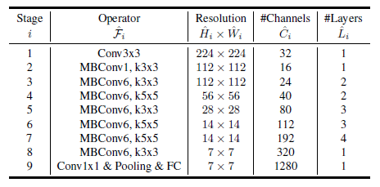
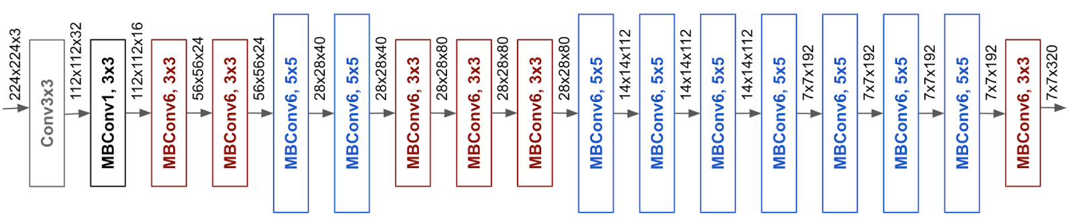

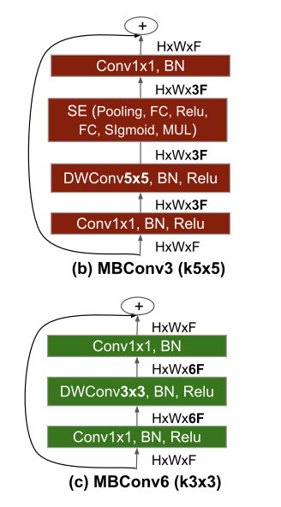
2.Based model – Efficient Net
Model | w | d | r*H,r*W
B0 | 1.0 | 1.0 | 224
B1 | 1.0 | 1.1 | 240
B2 | 1.1 | 1.2 | 260
B3 | 1.2 | 1.4 | 300
B4 | 1.4 | 1.8 | 380
B5 | 1.6 | 2.2 | 456
B6 | 1.8 | 2.6 | 528
B7 | 2.0 | 3.1 | 600
L2 | 4.3 | 5.3 | 475
EfficientNet-B0

Slide 7
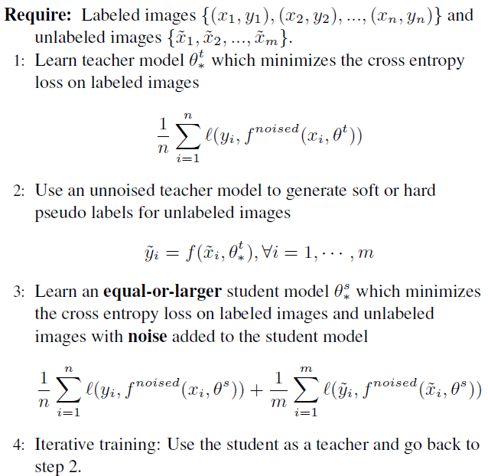

3.Loss function

Slide 8
4.Dataset
Labeled dataset.
-ImageNet 2012 ILSVRC challenge prediction task
Unlabeled dataset.
-JFT dataset,
is an internal Google dataset used for training image classification models,which has around 300M images.
ignore the labels and treat them as unlabeled data.
Notes:
We then select images that have confidence
of the label higher than 0.3. For each class, we select at most
130K images that have the highest confidence. Finally, for
classes that have less than 130K images, we duplicate some
images at random so that each class can have 130K images.

Slide 9
Data filtering and balancing.
First, we run an EfficientNet-B0 trained on ImageNet over the JFT dataset to predict a label for each image.
We then select images that have confidence of the label higher than 0.3.
For each class, we select at most 130K images that have the highest confidence.
Finally, for classes that have less than 130K images, we duplicate some images at random so that each class can have 130K images.

Slide 10
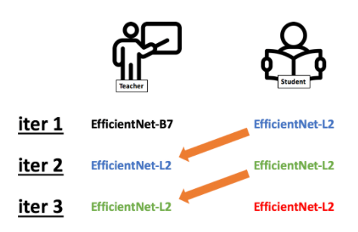
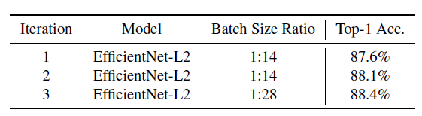
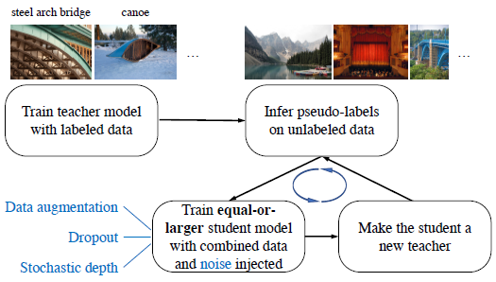
5.Training Detail
Training student 350 epochs
The learning rate starts at 0.128 for labeled batch size 2048 and decays by 0.97 every 2.4 epoch.
Label data
unLabel data
Notes:
Epoch
Learning rate
各參數設定值…
The best model in our experiments is a result of three iterations of putting back the student as the new teacher.

Slide 11
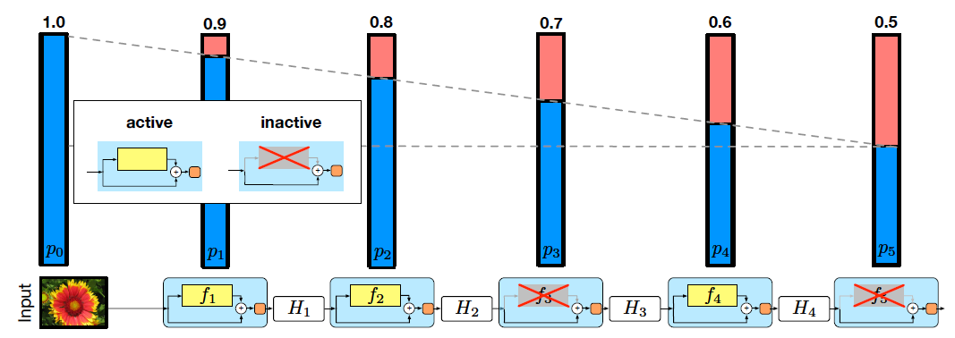
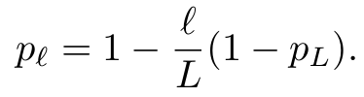
Noise
Input Noise: data augmentation with RandAugment
Model Noise:
Dropout: to the final layer with a dropout rate of 0.5
Stochastic depth : set the survival probability in stochastic depth to 0.8 for the final layer
Notes:
We use stochastic depth [37], dropout [75], and RandAugment [18] to noise the student.
The hyperparameters for these noise functions are the same for EfficientNet-B7 and L2.
In particular, we set the survival probability in stochastic depth to 0.8 for the final layer and follow the linear decay rule for other layers.
We apply dropout to the final layer with a dropout rate of 0.5.
For RandAugment, we apply two random operations with magnitude set to 27.
上面公式中的表示pl的是第l层在训练中的生存概率,L表示block的总数量，因此pL就是最后一个残差块的生存几率
RandAugment 不多作解釋，有意思的是後兩者。作者認為 dropout 及 stochastic depth 有助於 teacher model 形成 emsemble model，而不是以 regularization 的觀點理解。
when dropout and stochastic depth function are used as noise, the teacher behaves like an ensemble at inference time (when it generates pseudo labels), whereas the student behaves like a single model. In other words, the student is forced to mimic a more powerful ensemble model.

Slide 12
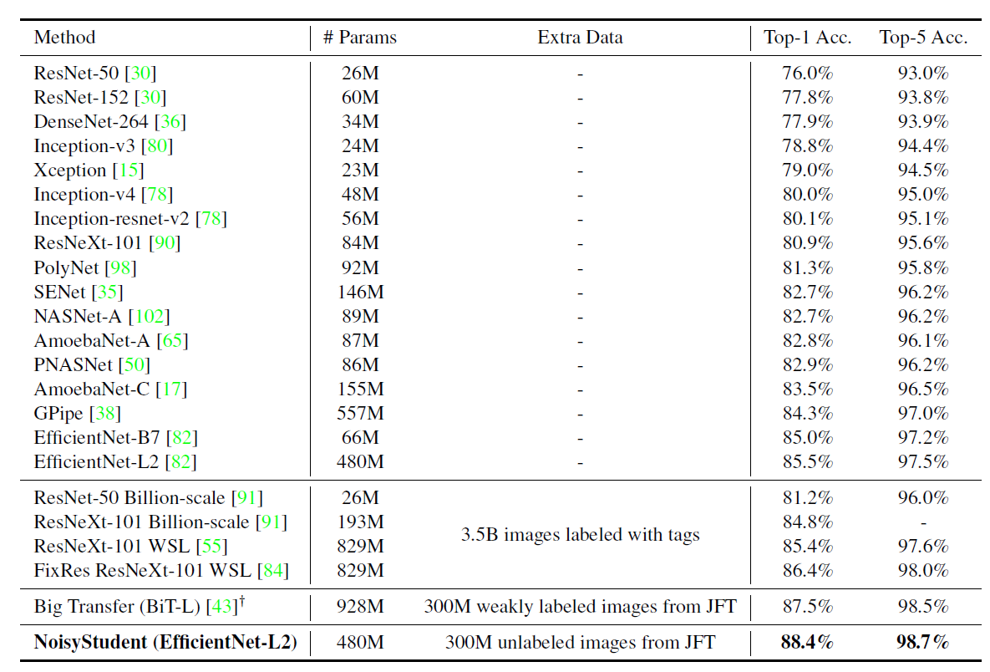
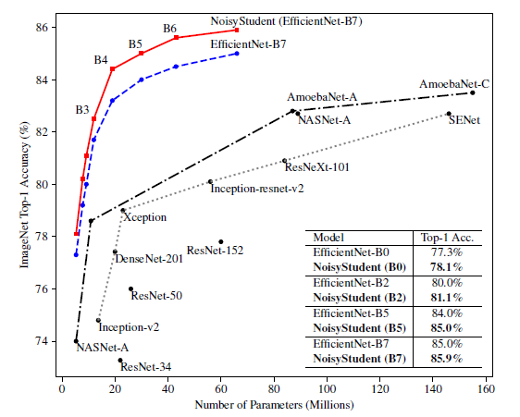
6.Result and Performance
But,EfficientNet-L2, needs to be trained for 6 days on a Cloud TPU v3 Pod, which has 2048 cores,
if the unlabeled batch size is 14x the labeled batch size.
Notes:
Top-1 and Top-5 Accuracy of NoisyStudent and previous state-of-the-art methods on ImageNet. EfficientNets
trained with NoisyStudent have better tradeoff in terms of accuracy and model size compared to previous state-of-the-art
models. NoisyStudent (EfficientNet-L2) is the result of iterative training for multiple iterations. †: Big Transfer is a concur-
rent work that performs transfer learning from the JFT dataset.

Slide 13
7.實作

Slide 14
7-1.Dataset:
CIFAR-10
32 * 32
這些影象涵蓋了10個類別：飛機， 汽車， 鳥， 貓， 鹿， 狗， 青蛙， 馬， 船以及卡車。
資料集總共包含60000張圖片，每個類別6000張。其中，訓練集包含50000張圖片，測試集包含10000張圖片
CINIC-10 is an augmented extension of CIFAR-10.
unlabel data total numbers:70,000 (for training)
Label data total numbers: 500 (for testing)
Notes:
CINIC-10 是 CIFAR-10 的增強擴展。 它包含來自 CIFAR-10 的圖像（60,000 張圖像，32x32 RGB 像素）和一系列 ImageNet 數據庫圖像（210,000 張圖像下採樣到 32x32）。 它被編譯為 CIFAR-10 和 ImageNet 之間的“橋樑”，用於對機器學習應用程序進行基準測試。 它被分成三個相等的子集——訓練、驗證和測試——每個子集包含 90,000 張圖像。

Slide 15
7-1. Dataset:
 | Training | Validation | Test
Teacher | CIFAR 10 Dataset Total:50,000 | CIFAR 10 Dataset Total:10,000 | CINIC Dataset Total:500
Student 1 | CIFAR10 Dataset + Pseudo label Total:120,000 | CIFAR 10 Dataset Total:10,000 | CINIC Dataset Total:500
Student 2 | CIFAR10 Dataset + Pseudo label Total:120,000 | CIFAR 10 Dataset Total:10,000 | CINIC Dataset Total:500
Student 3 | CIFAR10 Dataset + Pseudo label Total:120,000 | CIFAR 10 Dataset Total:10,000 | CINIC Dataset Total:500
Batch size = 64
Image size:32 * 32 * 3
Pseudo label data為CINIC-10資料集排除跟CIFAR 10相同的照片後，進行偽標籤後取Confidence Score > 0.3並每類依照Confidence Score由高至低排序取前7000筆資料，若資料數不夠就重複選取現有的資料。

Slide 16
7-2.訓練流程
Base model: MobileNet v1
Noise:
1.data augmentation with RandAugment
2. Stochastic depth (use in residual block)
3.Dropout rate = 0.1
Epoch:50
We then select images that have confidence of the label higher than 0.3.
Teacher_model
student_model_1
student_model_1
student_model_2
student_model_2
student_model_3

Slide 17
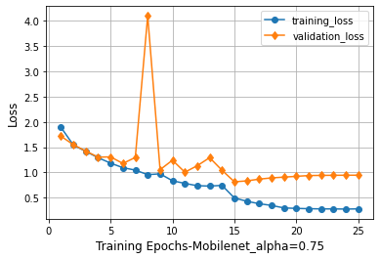
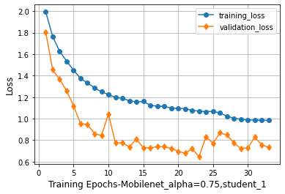
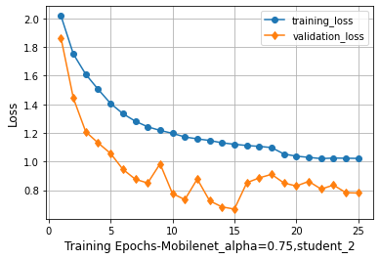
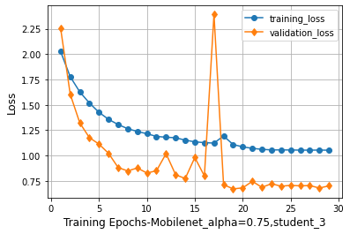
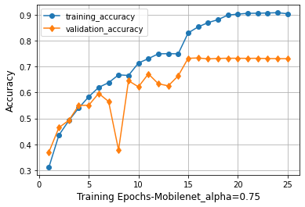
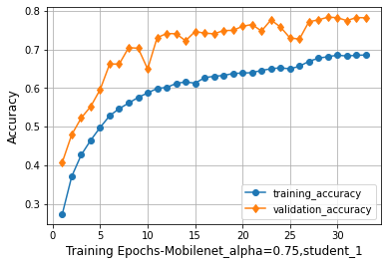
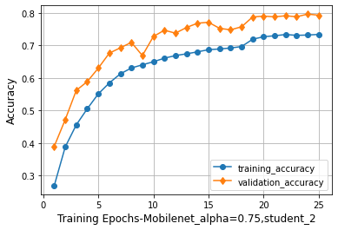
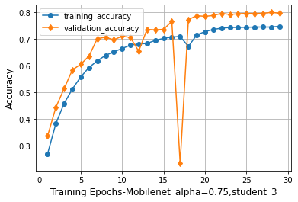
7-3.訓練結果:
Teacher Model
Student Model 1th
Student Model 2th
Student Model 3th
Testing Result
loss:2.1933
acc: 0.52
loss:1.4325
acc: 0.55
loss:2.0122
acc: 0.554
loss:1.6917
acc: 0.56

Slide 18
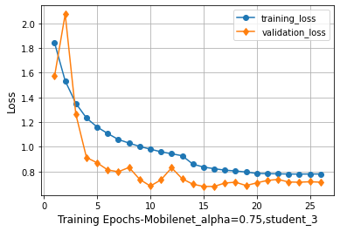
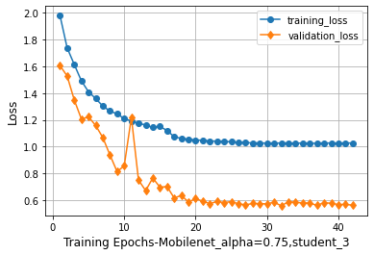
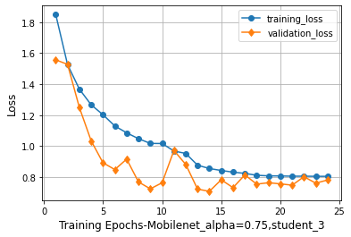
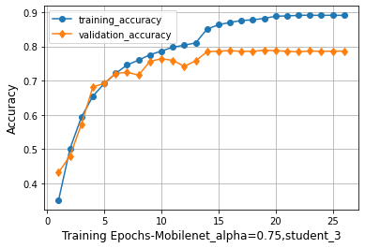
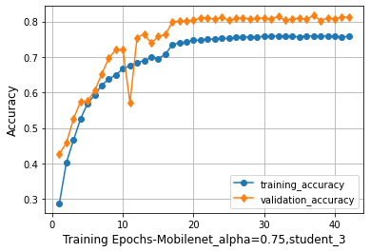
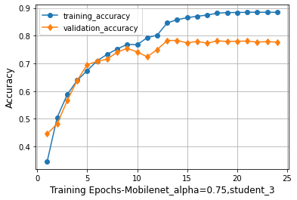
7-4.Noise 比較
Student Model 3th
(dropout and image noise)
Student Model 3th
(drop out)
Student Model 3th
(image noise)
Student Model 3th
(no noise)
Testing Result
loss:1.6917
acc: 0.56
loss:1.4091
acc: 0.558
loss:1.4147
acc: 0.558
loss:1.6321
acc: 0.564
Notes:
缺 no image dropout

Slide 19
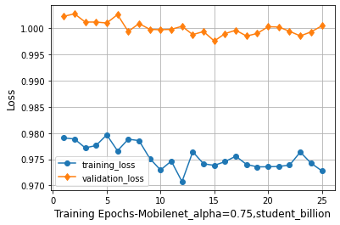
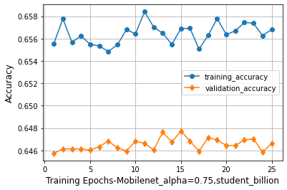
7-5.Billion-scale semi-supervised learning for image classification
Dataset:
 | Training | Validation
Teacher | CIFAR 10 Dataset Total:50,000 | CIFAR 10 Dataset Total:10,000
Student 1 pretrained | Pseudo label Total:40,000 Select K=4,000 | CIFAR 10 Dataset Total:10,000
Student 1 fintuning | CIFAR10 Dataset Total:50,000 | CIFAR 10 Dataset Total:10,000
Test:
CINIC Dataset
Total:500
設K=4,000，因在進行偽標籤時，最少類別的個數為4000多。並在此paper也無進行照片增量的動作。故只取K=4000，最後訓練結果也沒有比較好。也可能是因unlabeled的數量不太夠。
loss:1.6358
acc: 0.488

Slide 20
8.Reference
[1] TAN, Mingxing; LE, Quoc. Efficientnet: Rethinking model scaling for convolutional neural networks. In: International Conference on Machine Learning. PMLR, 2019. p. 6105-6114.
[2] XIE, Qizhe, et al. Self-training with noisy student improves imagenet classification. In: Proceedings of the IEEE/CVF Conference on Computer Vision and Pattern Recognition. 2020. p. 10687-10698.
[3] YALNIZ, I. Zeki, et al. Billion-scale semi-supervised learning for image classification. arXiv preprint arXiv:1905.00546, 2019.

